Slide 1
Financial Modeling
Capital Budgeting and Valuation Models
Jacqueline Garner, Ph.D.
Lecturer
Scheller College of Business
What is a Capital Budget?
Notes:
Hello, I’m Jacqueline Garner, and welcome to Financial Modeling

Slide 2
Before We Begin…

Slide 3
Capital Budgeting
Capital budgeting is the process by which a firm decides whether it will take on a new “project” or investment. The investment is funded via the firm’s capital structure (debt and equity).
Examples of a new project are as simple as replacement of machinery or as complex as purchasing a new plant.

Slide 4
Capital Budgeting
Goal of capital budgeting mimics the goal of the firm:
To increase the value to shareholders
The basic decision:
Is the price of the investment worth the cash flows the investment produces?

Slide 5
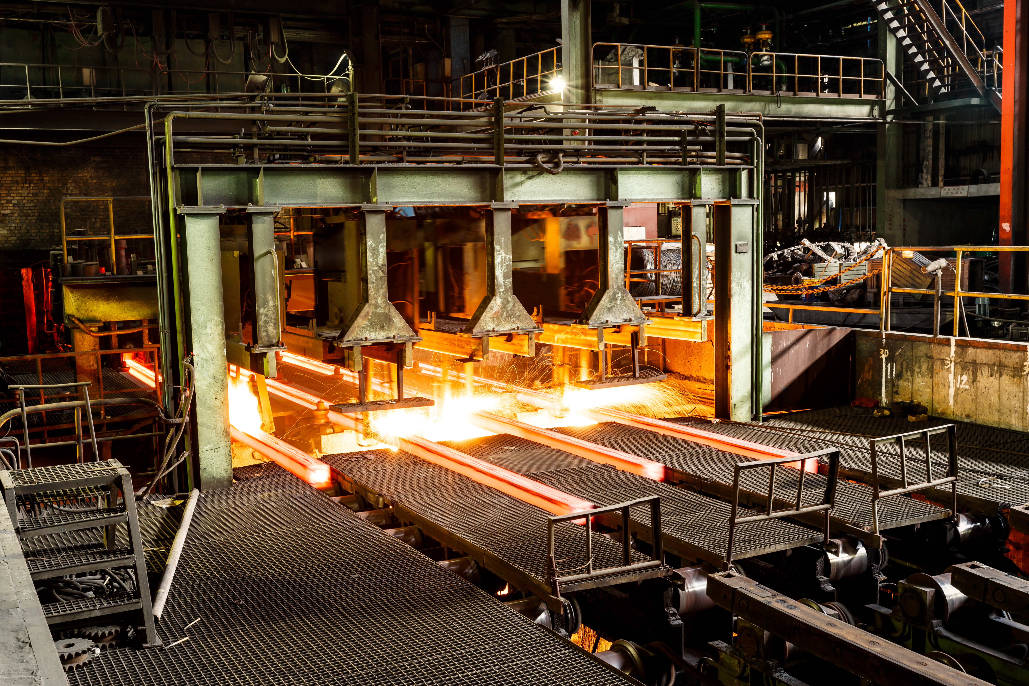
Capital Budgeting
Suppose a firm considered buying a steel mill and keeping it for 5 years.
Outflow for the mill at t = 0
The mill will produce cash flows from
t = 1 to t = 5
Basic question: Is the discounted value of the cash flows more than the price at t = 0?

Slide 6
Summary

